Slide 1



Slide 2
Transport in Humans
Blood
Wendy Chai

Slide 3

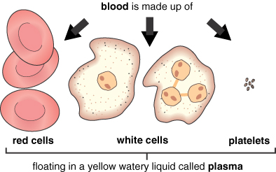
Blood

Slide 4
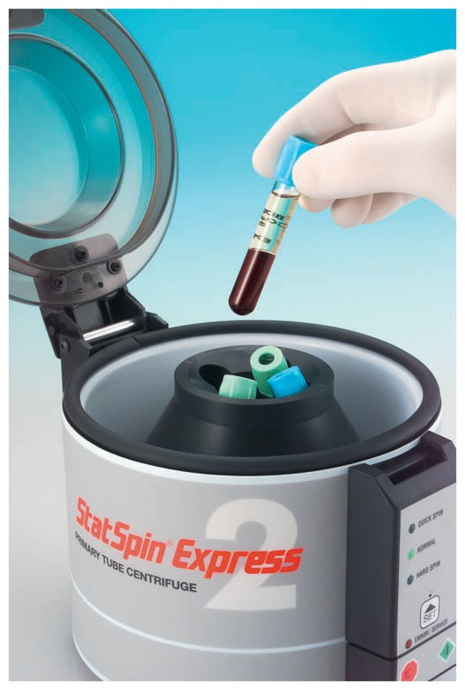
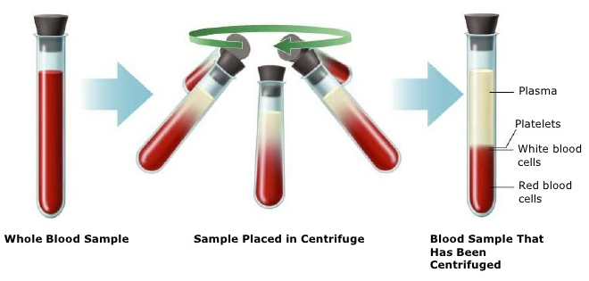
centrifuge

Slide 5
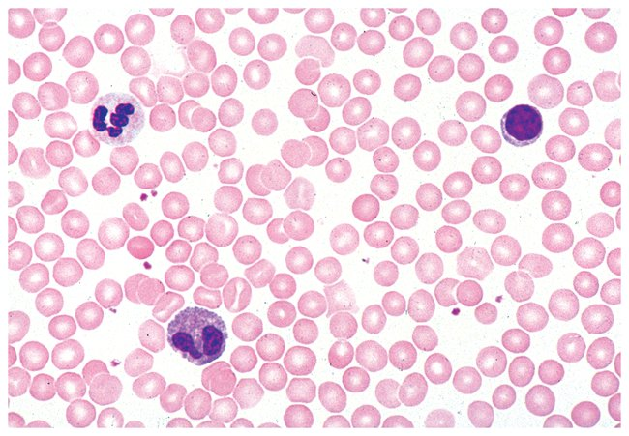
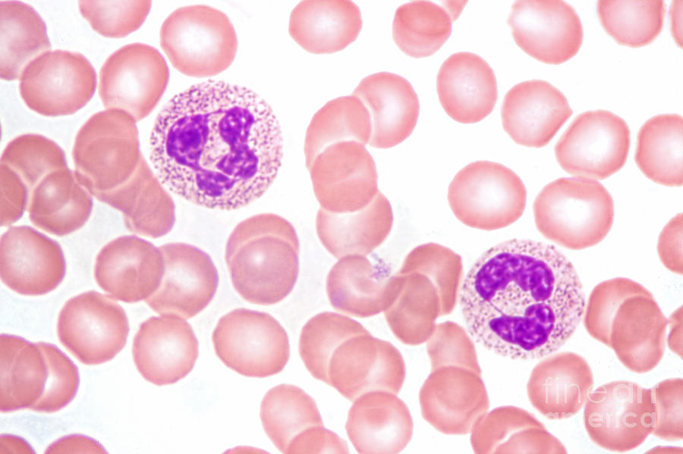
Blood smear

Slide 6
Plasma
Plasma makes up about 55% of blood volume. It consists of water with chemicals dissolved in it:
nutrients, such as glucose, amino acids, vitamins and mineral ions
wastes, such as urea and carbon dioxide
proteins, such as albumin, fibrinogen and antibodies
hormones, such as insulin and adrenaline.
plasma proteins

Slide 7
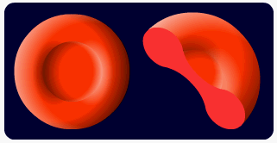
Red blood cells
Their function is to transport oxygen to cells in the body.
Structures/ Adaptations of RBC:
1) They contain haemoglobin, which combines with oxygen to form oxyhaemoglobin.

Slide 8
Red blood cells
2) They do not have a nucleus, so there is more space for more haemoglobin molecules to be packed into each cell.
3) They have a biconcave shape, which gives a larger surface area to volume ratio for absorbing oxygen.
Surface area
volume

Slide 9
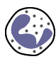
White blood cells
White blood cells are important in protecting the body against infection from microbes, such as bacteria. There are two main types:
1) Phagocytes – these surround invading microbes and engulf them in a process called phagocytosis. Once inside the cell, the microbes are digested by enzymes and destroyed.
Phagocytes often have lobed nucleus.

Slide 10
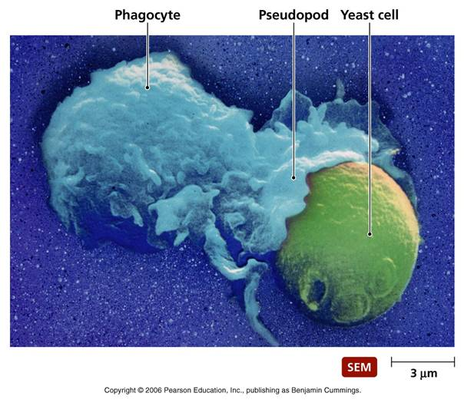
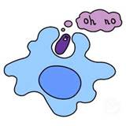
Phagocytes
Phagocytes can squeeze out of capillaries and get into most parts of the body.

Slide 11
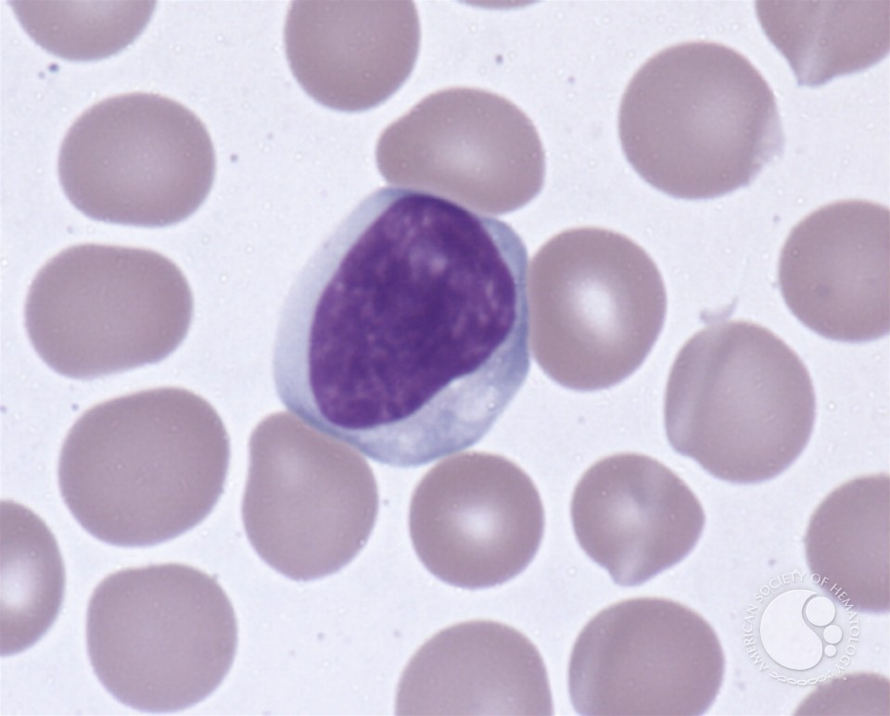
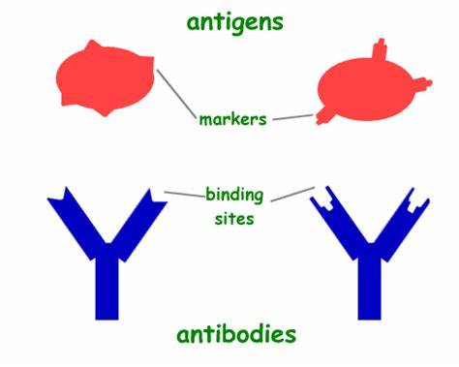
White blood cells
2) Lymphocytes – these produce special proteins called antibodies, which are used in the destruction of invading microbes (pathogens).

Slide 12
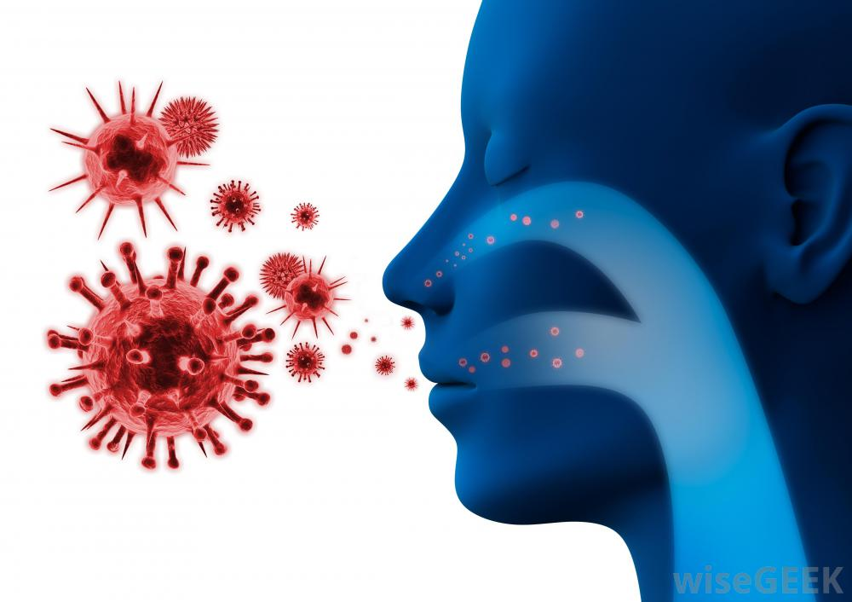
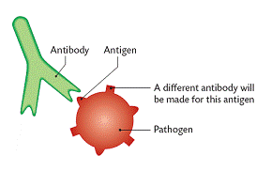
Antibody V.S. antigen
Each antibody has a complementary shape to a specific type of antigen (which is on the surface of pathogen)

Slide 13
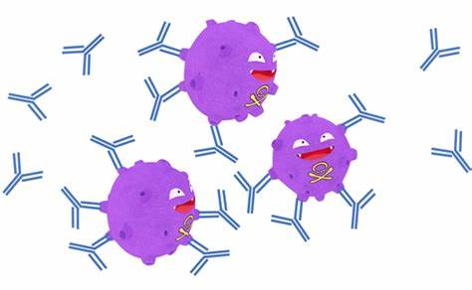
Lymphocytes
Antibodies attack pathogens in several ways:
1) They recognize a unique antigen and lock onto it.
2) they make pathogens stick together hence reduce their chance of getting into body cells.
3) they destroy pathogens directly.
4) They mark pathogens and alert phagocytes to destroy them by phagocytosis.
5) they neutralise the toxins that some pathogens, e.g. bacteria, produce.

Slide 14
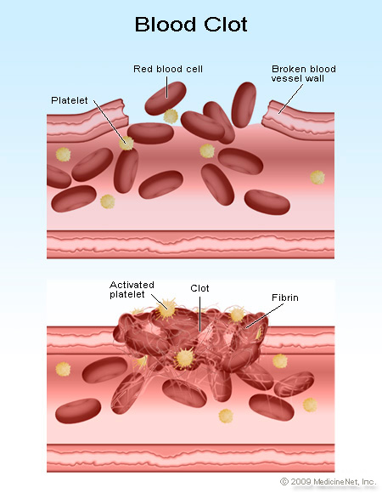
Platelets
These are tiny fragments of cells that help the blood to clot.

Slide 15
Functions of Blood - Summary
Part of the blood | Functions
Red cells | Contain haemoglobin for oxygen transport
White cells | Phagocytosis and antibody production
Platelets | Important in blood clotting
Plasma | Transport of blood cells, ions, soluble nutrients, hormones, carbon dioxide, urea and plasma proteins

Slide 16
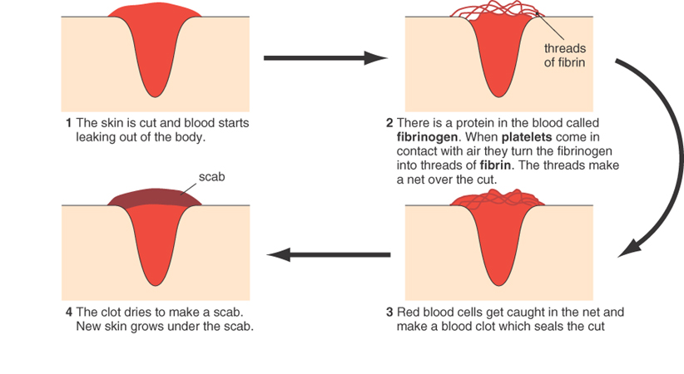
Blood clotting

Slide 17
Blood clotting
Blood clotting prevents loss of blood and the entry of pathogens.

Slide 18
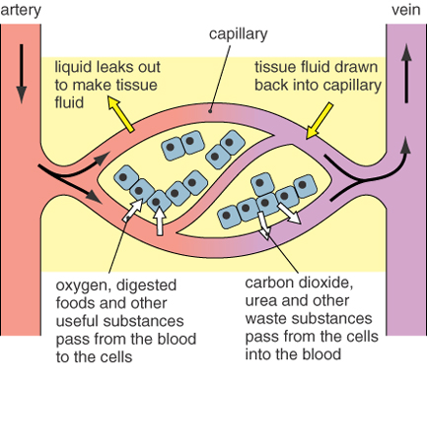
Tissue fluid

Slide 19
Tissue fluid
When blood reaches body tissues, some parts of the plasma move out through small gaps in the capillary walls to form tissue fluid.
Tissue fluid surrounds the cells and provides a stable environment for them.
White blood cells can squeeze out of the capillaries through the gaps in the wall.
Red blood cells stay in the blood.

Slide 20
Tissue fluid
Tissue fluid allows substances to diffuse into and out of cells.
Useful substances, like glucose and oxygen, pass from the tissue fluid into cells.
Waste products, like CO₂ and urea diffuse out of the cells into the tissue fluid.
Most of the tissue fluid then passes back into the blood capillaries.

Slide 21
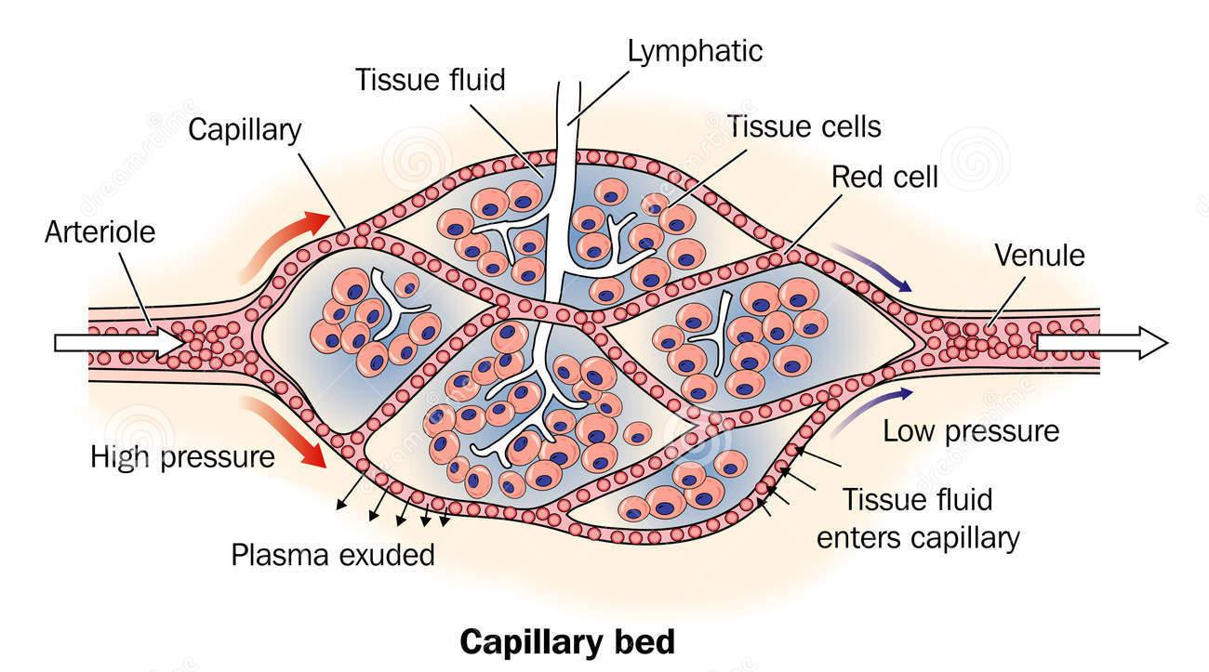
Tissue fluid

Slide 22
Tissue fluid

Slide 23
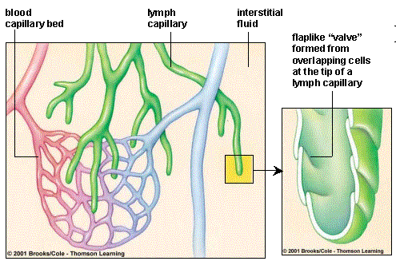
Lymph vascular system
Fluid enters lymph capillaries.
Capillaries merge into lymph vessels.
Lymph vessels converge into ducts that funnel fluid into veins at subclavian vein(in the lower neck ).

Slide 24
Lymphatic system
When tissue fluid enters the lymph capillaries it is called lymph.
Lymph consists of plasma and white cells, but has no red cells or plasma proteins.
The lymphatic system has a separate circulation which returns lymph to the blood.
Functions:
1) send excessive fluid back into blood;
2) filter blood (e.g. clear pathogens while lymph pass lymph nodes)/ immune defense;
3) absorb fat by lacteals from digestive system.

Slide 25
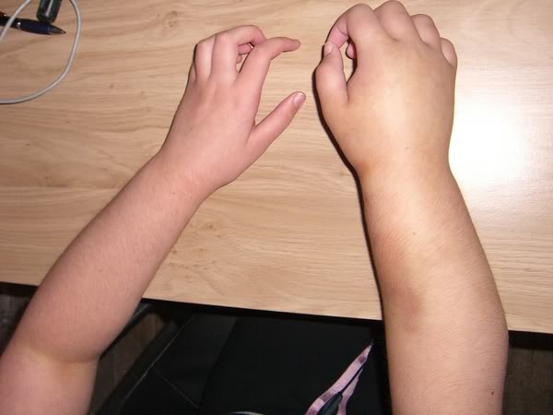
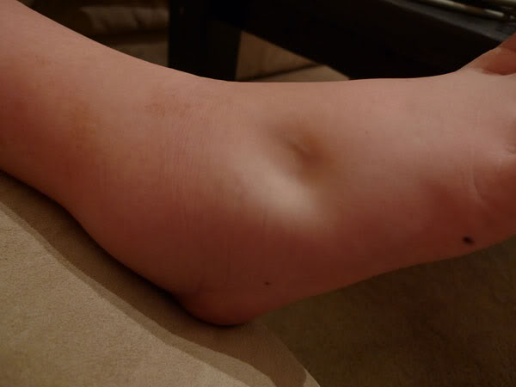
oedema

Slide 26
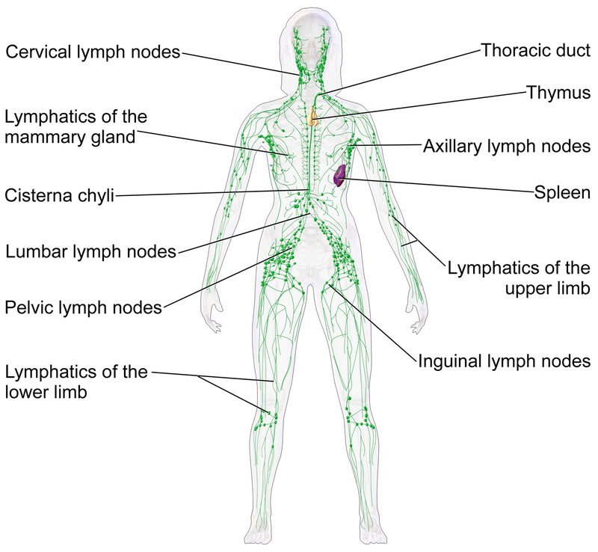

Slide 27
Lymphatic system
Lymphocytes are found in lymph nodes where they multiply during an infection and produce antibodies.
Some lymphocytes leave the lymph nodes and travel around the body in the blood, where they search for fresh invasions of pathogens.
The lymphatic system is an important part of the body’s immune system.

Slide 28
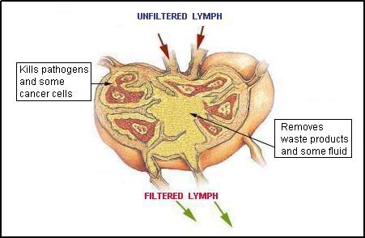
Lymphatic system
What happens in a lymph node?

Slide 29
The immune system
The immune system protects the body in several ways:
antibodies are produced against invading microbes by lymphocytes
phagocytes engulf invading microbes and digest them
foreign tissues (non-self) are rejected and destroyed. (in organ transplantation)

Slide 30
Blood, tissue fluid and lymph
Component | Blood | Tissue fluid | Lymph
red blood cells | ✓ |  | 
white blood cells | ✓ | some | some
water | ✓ | ✓ | ✓
plasma proteins | ✓ | some | some
glucose | ✓ | ✓ | very little
antibodies | ✓ | ✓ | ✓
fats | ✓ | some | ✓

